Slide 1
Superset
Data Visualization at AirBnB

Slide 2
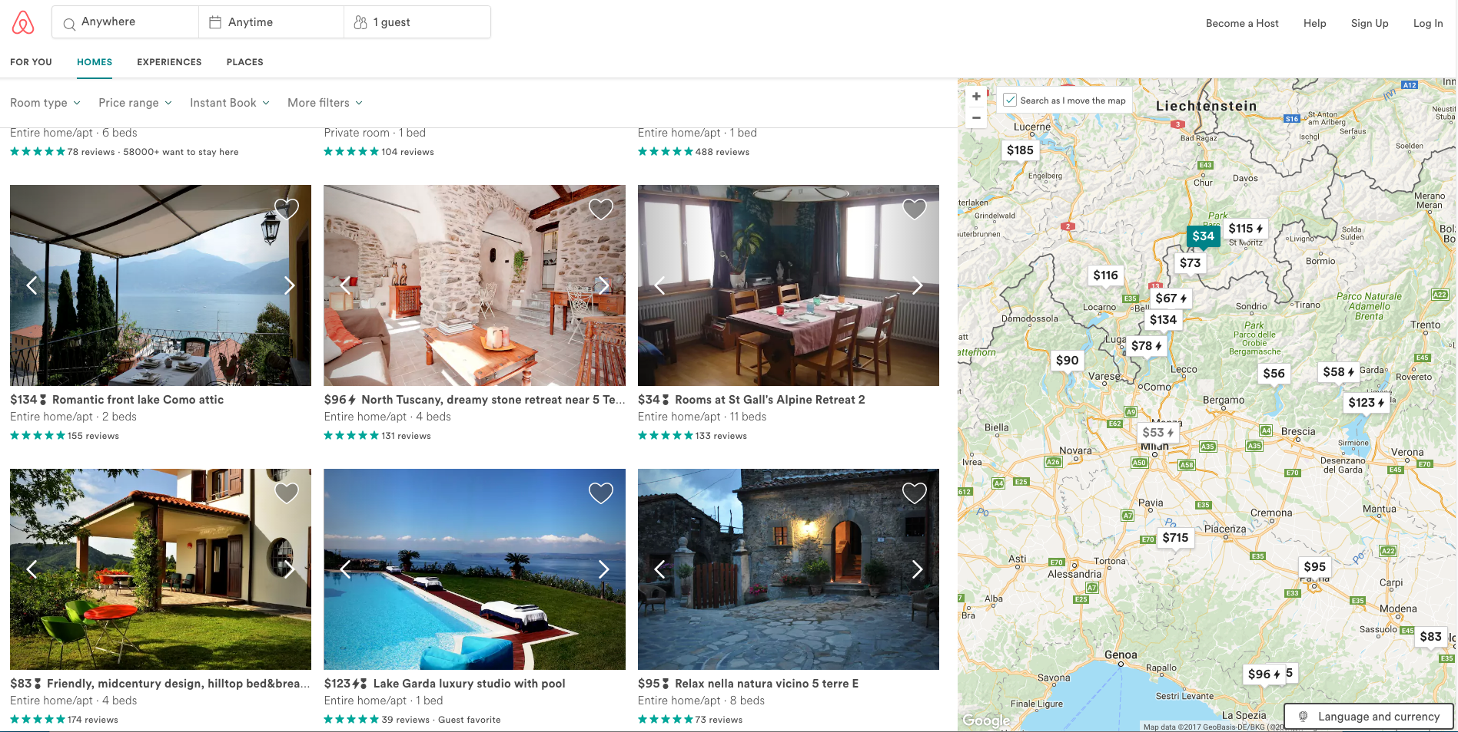

Slide 3
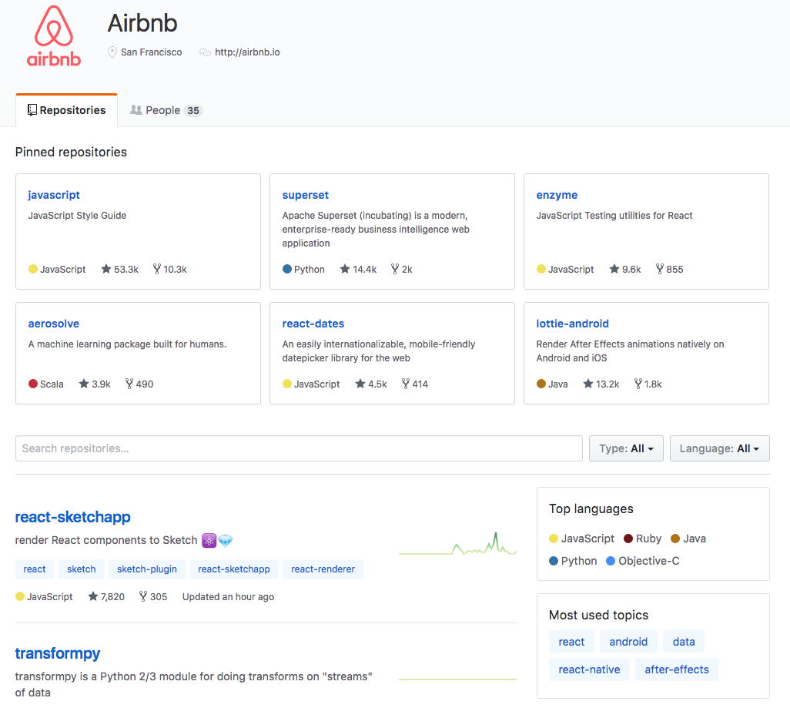

Slide 4
Features of Superset
Example: atacmonitor.com

Slide 5
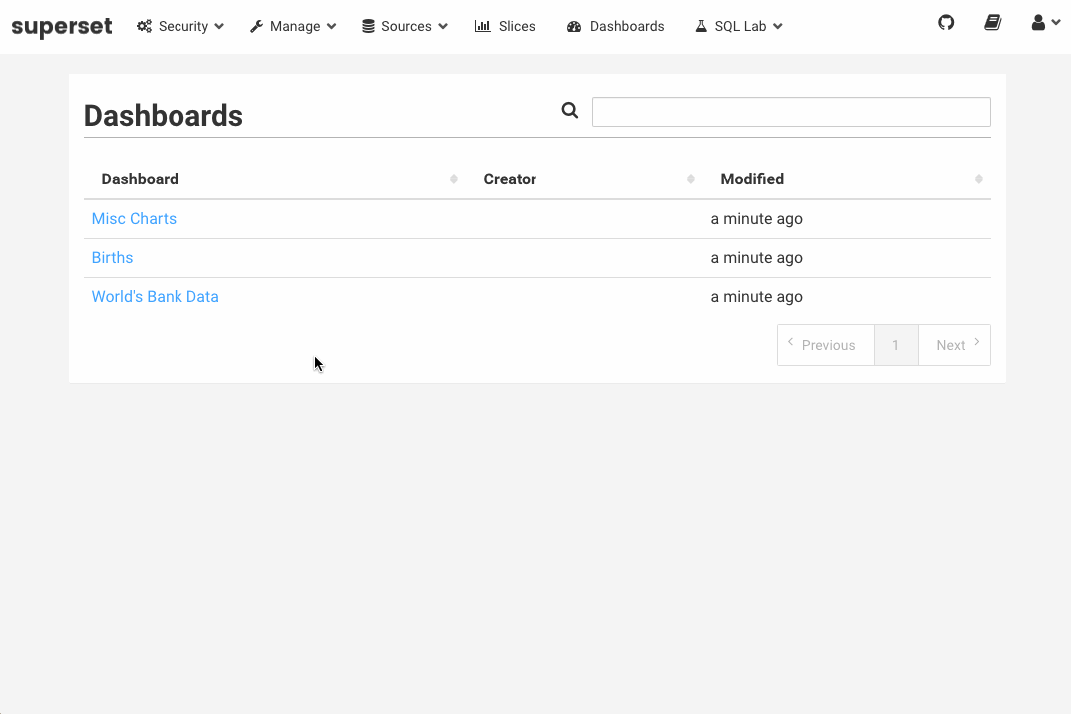

Slide 6
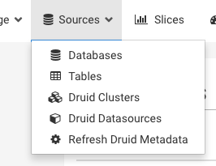
Connectivity
Most SQL-speaking databases
query layer = SQLAlchemy. Queries translated to most SQL dialects
Druid.io for fast realtime analytics
Notes:
cd superset_demo
pip install superset
fabmanager create-admin --app superset
# initialize the database
superset db upgrade
superset load_examples
# create default roles and permissions
superset init
superset runserver

Slide 7
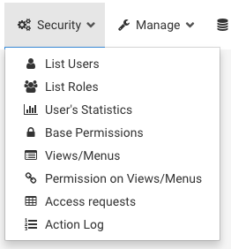
Authentication & Authorization
Flexible authentication
LDAP, OpenID, OAuth, Remote User, and more
Granular permissions and role management

Slide 8
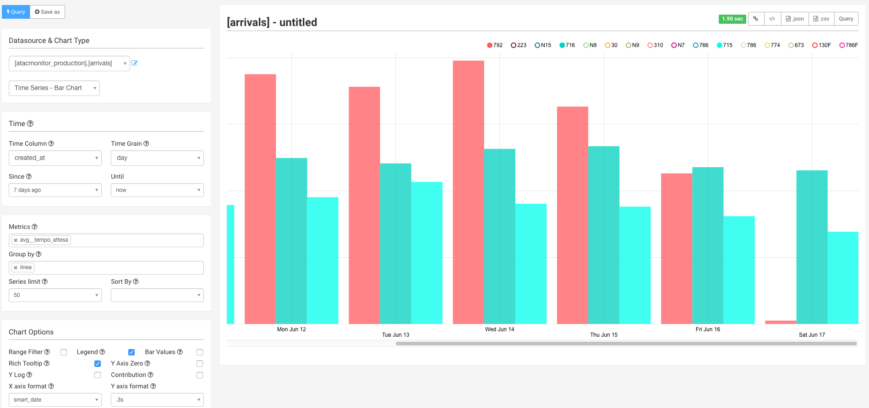
Codeless Approach…
Target != Data Science
At AirBnB: intuitive vehicle for sharing data and ideas

Slide 9
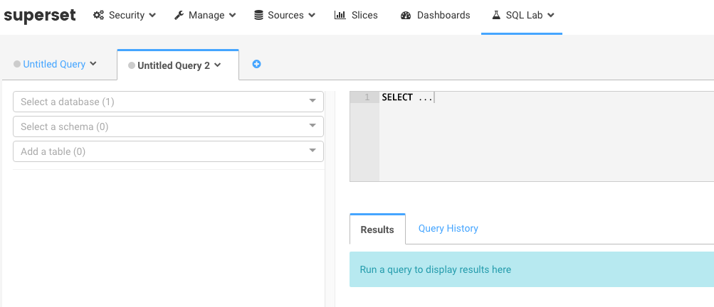
… but SQL still possible

Slide 10
Caching
Configurable caching options for loading dashboards.
Cascading timeout parameters by report, table and database

Slide 11
Remarks
Written in Python
Fast reaction to GitHub issues from the team
CSS templates

Slide 12
Setup
# Install superset
pip install superset
# Create an admin user
fabmanager create-admin --app superset
# Initialize the database
superset db upgrade
# Load some data to play with
superset load_examples
# Create default roles and permissions
superset init
# Start the web server on port 8088
superset runserver

Slide 13
Features of Superset
Example: atacmonitor.com

Slide 14



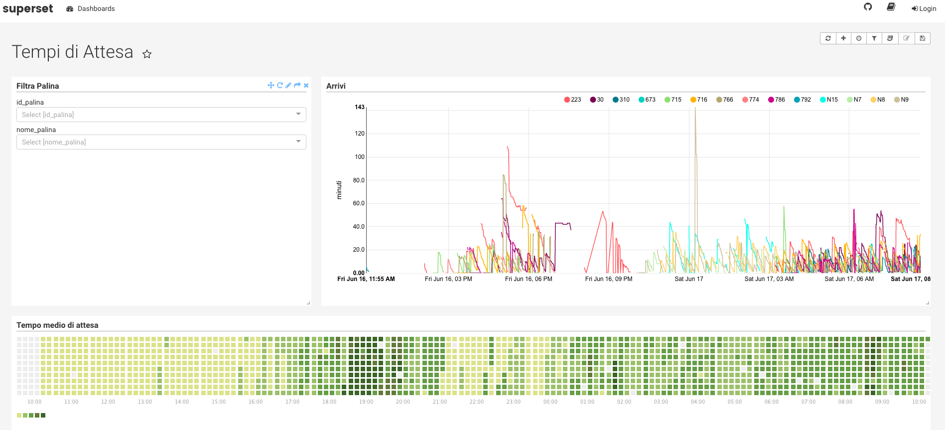
Architecture
Data Collection
API
Data Collection

Slide 15
atacmonitor.com
architecture
demo
call for action

Slide 16
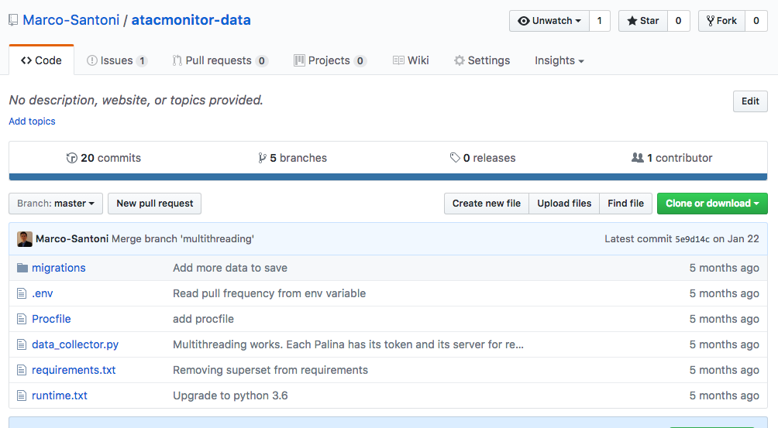
Open Project
Goals:
from 5 to 8588 stops
analyze the data
define KPIs
report service disruptions
tweet bot
alert anomalies
best/worst line of the week
contributions are welcome!!

Slide 17
Thank you
@MrSantoni
marcosantoni@hotmail.it

